Slide 1
March 2020
The Design, Development and Deployment of an Electronic Immunization Registry: Reflections and Guidance from Vietnam
Dr. Nguyen Tuyet Nga -Vietnam Country Director, PATH, Vietnam
Dr. Dang Thi Thanh Huyen - Vice Head, NEPI Office National Institute of Hygiene and Epidemiology, Vietnam
Mr. Dao Dinh Sang – Program Officer, PATH, Vietnam
Maya Rivera- Communications Officer, PATH, Vietnam
Notes:
Nga to present 1-2 slides

Slide 2
The faces behind the webinar….
INSERT DR. HUYEN NEPI PHOTO
Dr. Dang Thi Thanh Huyen - Vice Head, NEPI Office National Institute of Hygiene and Epidemiology, Vietnam
Dr. Nguyen Tuyet Nga -Vietnam Country Director, PATH, Vietnam
Mr. Dao Dinh Sang – Program Officer, PATH, Vietnam
Ms. Maya Rivera – Communications Officer, PATH, Vietnam
Notes:
Maya to present 24-28 slides

Slide 3
Agenda:
Presentation- 15 min
Introducing IDEAL-Vietnam
History and Functions of the NIIS
Design
Development
Deployment
Next steps
Interview with National Expanded Program on Immunization and PATH IDEAL colleagues – 15 min
Discussion/Q&A – 15 min

Slide 4
National Expanded Program on Immunization in Vietnam
Annual birth cohort : ~1.7 million.
Most vaccines are given at commune health centers on monthly immunization days (weekly in some provinces) except for the Hepatitis B birth dose.
There are geographic inequalities, with lower coverage rates in hard-to-reach areas.
Before June 2017, immunization information systems were primarily paper-based systems, with some computer-based systems for reporting aggregated data.
Notes:
Huyen to present 3-8 slides

Slide 5
EPI structure in Vietnam
Ministry of Health
General Department of Preventive Medicine
National Institute of Hygiene and Epidemiology (NIHE)
National Expanded Program on Immunization (NEPI)
Northern IHE/EPI
Pasteur Institute of
Nha Trang
Pasteur Institute of Ho Chi Minh City
Central Highlands IHE
28 Preventive Medicine Centers/CDCs
11 Preventive Medicine Centers/CDCs
20 Preventive Medicine Centers/CDCs
4 Preventive Medicine Centers/CDCs
Provincial Health
Departments
District Health Centers
District Health Centers
District Health Centers
District Health Centers
Hospitals
Fee-based
facilities
Commune Health Centers
Commune Health Centers
Commune Health Centers
Commune Health Centers

Slide 6
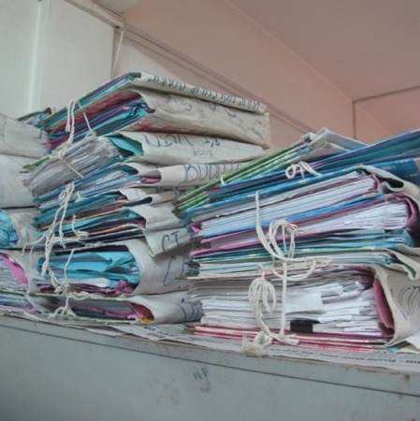
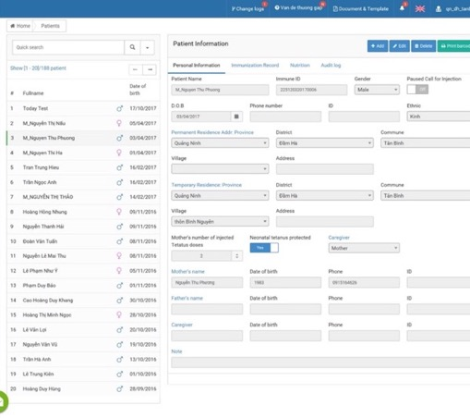
From paper-based records to a national digital database: ImmReg and the National Immunization Information System (NIIS)
Notes:
This project stems from the work on the digital immunization registry that started with Project Optimize, which was a partnership between PATH and WHO back in 2010-2012. Project Optimize aimed to find new ways to improve immunization coverage for women and children, including a digital immunization registry and vaccine tracking tool. PATH then scaled up these systems in Ben Tre province, where it was shown to improve on-time vaccination coverage and reduce time and costs related to routine immunization programs, and after that, the MOH developed the National Immunization Information System (NIIS)
In Vietnam, Commune Health Centers (CHCs) are the primary point of delivery of vaccines for pregnant women and children. Currently, CHCs use a paper based registry system to register clients, notify them when they are due for vaccinations and record their doses. Reports are aggregated from hand-written ledgers and frequently take a week or more to reach officials at the district and province level. This system is time consuming and prone to error. Hand written information and manual calculations lead to inaccurate data, which compromises the ability of the CHCs to protect the population from vaccine-preventable diseases.
Data inaccuracies = poor planning and management of vaccine stocks and overall lack of efficiency
Final evaluation from Ben Tre pilot: one year after intervention, on time vaccination rate increased up to 20%, drop out rate for BCG-Measles 1 from 12.8% downed to 0%

Slide 7
From ImmReg and VaxTrak to the National Immunization Information System

Slide 8
Design:
Defining EIR requirements based on end-user priorities and identified prolems.
Development:
Creating and testing of EIR software based on predetermined system needs and key functions
Deployment:
Introduction of the EIR system across relevant levels of the health systsm

Slide 9
System functions: Immunization Registry Module
Commune Health Center
Barcode Scan
SMS Reminder
Immunization Tracker & Planning
Dashboard and reports
E-Immunization Card
Under development
Fee-based Immunization Facility
Hospital
Notes:
Children registered into the system at hospital soon after birth, information of children will be sent to health commune health center where child is residence and notify health worker there know about the newborn.
Before immunization days, system help to list children due on vaccination and send SMS (feature phone) or pop-up notification on smartphone if parents use smartphone installed e-immunization card. And based on the list of children due on vaccination, the system suggest number of dose of a specific vaccine for the immunization.
On immunization day, children visit CHC, health worker use barcode scanner easy to find right child and update immunization data.
System generate reports and dashboard to support manager to make decision, make plan for vaccine, vaccination and supportive supervision

Slide 10
Introducing Digital immunization information systems: Exchange And Learning from Vietnam
Notes:
Sang to present 9-21 slides

Slide 11
IDEAL-Vietnam
Goal: To explore and disseminate evidence and lessons learned from Vietnam’s implementation of the NIIS to support successful implementation of EIRs in other countries.
By the end of the project, we will have published and disseminated actionable lessons learned from the Vietnam context to contribute to the growing body of guidance and evidence emerging, by contributing knowledge gained from a national scale established system in a middle-income country. This will include implementation guidelines based on the Vietnam experience, as well as academic publications that feature key analyses and collected learnings to inform governments, as well as normative and donor agencies.
We will encourage awareness and adoption of this information by publishing our work in a variety of media sources and peer-reviewed publications, and diffuse our learnings at conferences and in community forums.
We aim to create awareness and understanding of Vietnam’s experience to inform, influence, and accelerate the successful implementation of similar tools at a global scale.
We also aim to use this project to help the MOH improve the uptake and effective use of the NIIS.
Notes:
This project stems from the work on the digital immunization registry that started with Project Optimize, which was a partnership between PATH and WHO back in 2010-2012. Project Optimize aimed to find new ways to improve immunization coverage for women and children, including a digital immunization registry and vaccine tracking tool. PATH then scaled up these systems in Ben Tre province, where it was shown to improve on-time vaccination coverage and reduce time and costs related to routine immunization programs, and after that, the MOH developed the National Immunization Information System (NIIS)
Final evaluation from Ben Tre pilot: one year after intervention, on time vaccination rate increased up to 20%, drop out rate for BCG-Measles 1 from 12.8% downed to 0%

Slide 12
Stage 1: EIR Conception, Planning and Design
Notes:
Sang to present 9-21 slides

Slide 13
Stage 1: EIR Conception, planning and design
1. Conduct landscape assessments that prioritize end-users
The landscape analysis in Vietnam helped to identify and understand the problem, review policies, and determine current technical capacity and infrastructure
And provided a snapshot into existing capacity and challenges for implementing an EIR.
Assessments provided user feedback that helped to design a sustainable system.
Notes:
Talk about Vietnam experience and maybe some global comparisons.
.

Slide 14
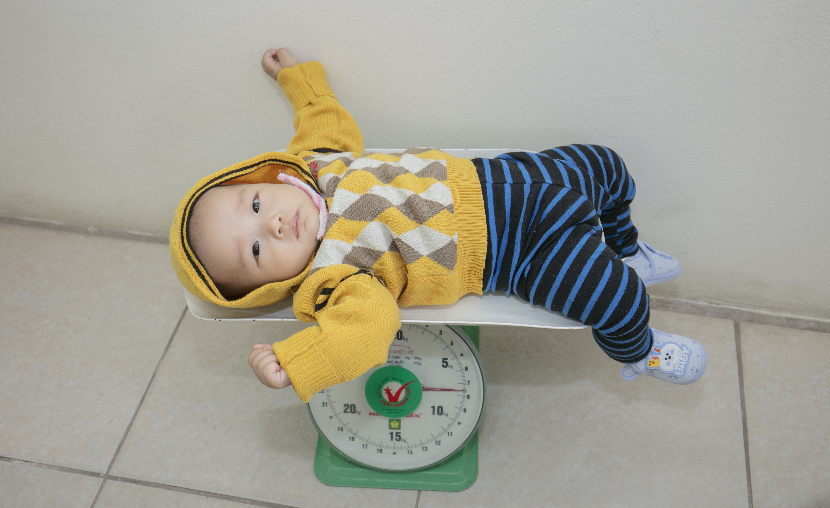
Stage 1: EIR Conception, planning and design
2. Establish a project team with clear leadership delegation
In Vietnam, MOH leadership was supportive and took the initiative for decision-making needed to scale up the EIR.
Supportive leadership helped to increase end-user commitment
Forming a TWG helped to communicate between expert groups and work with the system synergistically
Notes:
Talk about Vietnam experience and maybe some global comparisons.
Supportive leadership increased end-user commitment. In Vietnam, MOH leadership was supportive and took the initiative for decision-making needed to scale up the EIR. Supportive leadership helped to increase end-user commitment by mandating usage of the system at all levels, allocating resources where necessary, and planning for the future.
Forming a TWG or having a national technical support team was key in Vietnam. The TWG helped to communicate between expert groups and work with the system synergistically

Slide 15
Stage 1: EIR Conception, planning and design
3. Perform a costing analysis
Cost-modeling for scale-up helps to ensure the sustainability of the project.
The budget needs to include formative research and the development, implementation and maintenance of the system.
A budget should be allocated for continuous improvements, oversight, and system maintenance with clear roles delegated to partners.
Notes:
Talk about Vietnam experience and maybe some global comparisons.
Cost-modeling for scale-up helps to ensure the sustainability of the project. The budget needs to include formative research and the development, implementation and maintenance of the system. A budget should be allocated for continuous improvements, oversight, and system maintenance with clear roles delegated to partners.

Slide 16
Stage 2: Development of the Software
Notes:
Sang to present 9-21 slides

Slide 17
Stage 2: Development of the Software
1. Define requirements
Ensuring functional requirements and system requirements helped to identify many critical data-related challenges within the paper-based system that needed to be solved through the development of an EIR.
These challenges were translated into system requirements to inform the development of the software in Vietnam.
Notes:
Ensuring functional requirements and system requirements are developed based on end-user needs helped to identify many critical data-related challenges within the paper-based system that needed to be solved through the development of an EIR. These challenges were translated into system requirements to inform the development of the software in Vietnam. Three different stages of the NIIS were used to assess user feed-back and ensure the key priorities from end-users were hard and then updated as needed.

Slide 18
Stage 2: Development of the software
2. Mapping to standard
Creating or establishing interoperability standards to govern an exchange between information systems is essential.
Interoperability strategies such as API, should be considered as early as possible during the development of the system.
Government leaders should develop policies to push facilities to connect to the system and exchange data.
Notes:
Talk about Vietnam experience and maybe some global comparisons.

Slide 19
Stage 2: Development of the Software
3. Testing
The scalability of the system should be considered. It is important to ensure that the EIR can support and sustain a large amount of data that continuously increases.
Stress tests need to be conducted to anticipate how many clients the system can store without slowing down the system and burdening end users who are using the system online.
Utilizing lessons learned from previous versions of the system saves time in scale-up and software development
Notes:
The scalability of the system should be considered. It is important to ensure that the EIR can support and sustain a large amount of data that continuously increases. Stress tests need to be conducted to anticipate how many clients the system can store without slowing down the system and burdening end users who are using the system online. Additional developments, like separating the database and the online portal into two servers, should also be explored as possibilities.
Utilizing lessons learned from previous versions of the system saves time in scale-up and software development

Slide 20
Stage 3: EIR Deployment
Notes:
Sang to present 9-21 slides

Slide 21
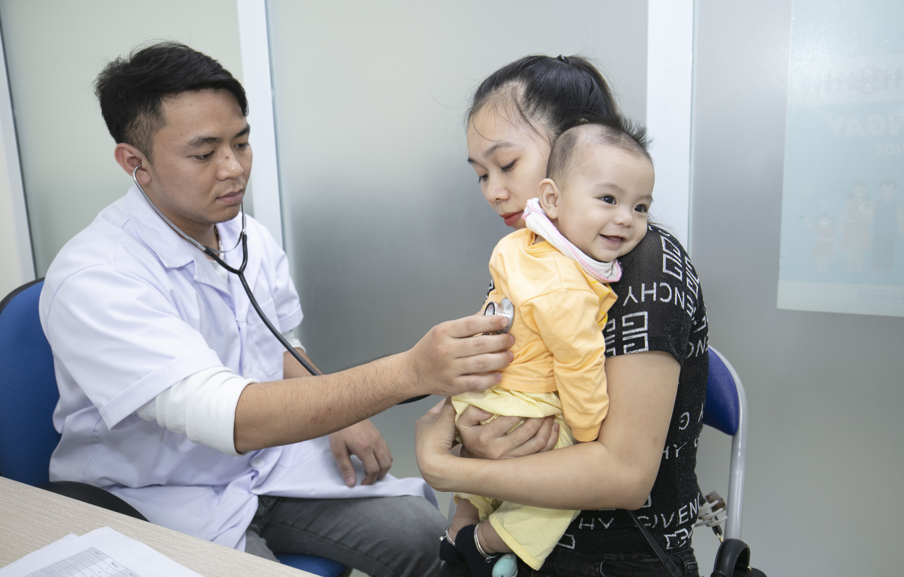
Stage 3: EIR Deployment
1. System Rollout
The pilot system in Vietnam helped to detect bugs in the system early on and understand acceptability from end-users
Notes:
Talk about Vietnam experience and maybe some global comparisons.

Slide 22
Stage 3: EIR Deployment
2. Establishing Human Resources
Human resources need to be under consideration early on because of staff turnover/changes
Documentation of the system is key so that if leaders who know the system well leave the team, the system can be understood by the replacement staff.
Allocating human resources from experienced nongovernmental organizations is a good way to save money and develop a well-balanced and experienced working team.
Notes:
Human resources need to be under consideration early on because of staff turnover/changes. There should always be several employees who have the same level of knowledge and expertise of the EIR to ensure that work can continue should one person leave the team. Documentation of the system is key so that if leaders who know the system well leave the team, the system can be understood by the replacement staff.
Allocating human resources from experienced nongovernmental organizations is a good way to save money and develop a well-balanced and experienced working team.

Slide 23
Stage 3: EIR Deployment
3. Training
Refreshment training is still needed to improve the end-users’ knowledge and skills.
With limited financial resources, e-learning is a useful source of training.
Notes:
Talk about Vietnam experience and maybe some global comparisons.

Slide 24
Stage 3: EIR Deployment
4. Implementation Burden
Protocols should be developed to recognize duplications between both the paper and digital systems.
Detailed SOPs for the detection of duplications were developed in Vietnam and training was provided for health workers with clear roles and responsibilities for each level of staff.
Notes:
Protocols should be developed to recognize duplications between both the paper and digital systems. Detailed SOPs for the detection of duplications was developed in Vietnam and training was provided for health workers with clear roles and responsibilities for each level of staff.
The search function in the NIIS covers different key variables before a clients’ data are allowed to be entered into the system.

Slide 25
Stage 3: EIR Deployment
5. Data Quality and Data Use
Data quality should be ensured by monitoring and evaluation activities.
Routine review and data quality checks should be conducted regularly to ensure that all end users are entering the data into the system (on-time, completely and accurately)
In Vietnam, a readiness assessment helped to assess the data quality and determine the readiness to move to entirely paperless.
Notes:
Talk about Vietnam experience and maybe some global comparisons.
Data quality should be ensured by monitoring and evaluation activities. Routine review and data quality checks should be conducted regularly to ensure that all end users are entering the data into the system (on-time, completely and accurately)
In Vietnam, a readiness assessment in 2019, helped to assess the data quality and determine the readiness to move to entirely paperless. Moving forward, local government and health leaders should emphasize the importance of data quality and enforce complete data input.

Slide 26
Post- Deployment: Sustained Use of the System and the Continuation to Paperless:
As Vietnam continues to move forward to a completely paperless immunization record system, it is important to continue monitoring user feedback and assess the acceptability of the system. The following factors should be continuously analyzed:
Resistance to change
Workload brought on by new data-entry procedures
Necessary time to register a new vaccine recipient into the system
Use of reports by different user profiles
Low system uptake from fee-based facilities
Data quality
Duplication due to the lack of unique client ID
Interoperability with other systems

Slide 27
Agenda:
Presentation- 15 min
Introducing IDEAL-Vietnam
History of NIIS/Scale-up
Facilitators/Barriers/Lessons learned
Next steps
Interview with National Expanded Program on Immunization and PATH IDEAL colleagues – 15 min
Discussion/Q&A – 15 min
Notes:
Should be 30 min in to presentation

Slide 28
Interview with National Expanded Program on Immunization (NEPI) and PATH
INSERT DR. HUYEN NEPI PHOTO
Dr. Dang Thi Thanh Huyen - Vice Head, NEPI Office National Institute of Hygiene and Epidemiology, Vietnam
Mr. Dao Dinh Sang – Program Officer, PATH, Vietnam:

Slide 29
Agenda:
Presentation- 15 min
Introducing IDEAL-Vietnam
History of NIIS/Scale-up
Facilitators/Barriers/Lessons learned
Next steps
Interview with National Expanded Program on Immunization and PATH IDEAL colleagues – 15 min
Discussion/Q&A – 15 min
Notes:
Last 15 minutes.

Slide 30
Any Questions? Comments?

Slide 31
Thank you for your time!

