Slide 1

BLN Webinar: Electronic Immunization Registries in Tanzania and Zambia: From Design to Deployment
BID Regional Mentors
Better data. Better decisions. Better health.
1

Slide 2
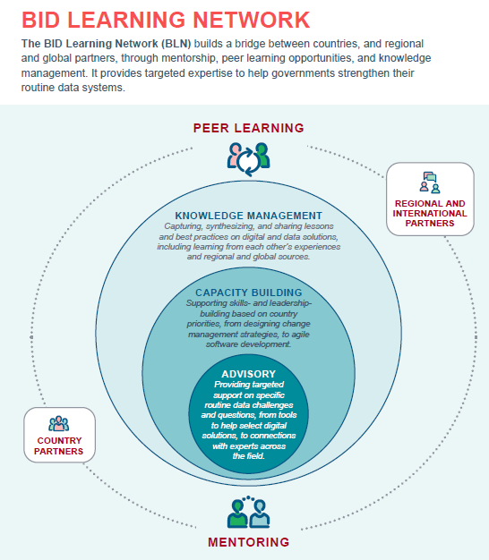

Slide 3
Webinar housekeeping
In the Chat box, type name and the country where you are connecting from – include number of other persons if sharing same connection
All participants will be muted and videos disabled to allow the speaker to present without interruption.
Q&A session will be held at the end of the presentation.
Questions can also be submitted via the chat box. They will be logged and answered during the Q&A session.
This webinar will be recorded. The link to the recording and presentation slides will be shared via the BID website.

Slide 4
Electronic IMMUNIZATION REGISTRIES IN TANZANIA AND Zambia : from design to deployment

Slide 5



Introducing the Speakers
Mr. Hassan Mtenga BID Regional Mentors Lead, PATH , TANZANIA | Mr. Paul Nindi System Project Manager PATH, ZAMBIA | Mr. John Richard Software Analyst PATH, TANZANIA

Slide 6

Electronic Immunization Registry Solutions Development Process
The case of Zambia and Tanzania
June 2020
Presenters:
Hassan Mtenga : Project Lead
Paul Nindi: Systems Project Manager
John Richard: Software Analyst

Slide 7
Introduction: Overview
BID regional introduction
Technology selection and considerations
Immunization Challenges to Digital Solution
Zambia Electronic Immunization Registry
Tanzania Electronic Immunization Registry
Notes:
What is mentors program ??
BID initiative & principles
Openness
Interoperable
Holistic
Partnership
Country owned
Reusable
Contribute to knowledge

Slide 8
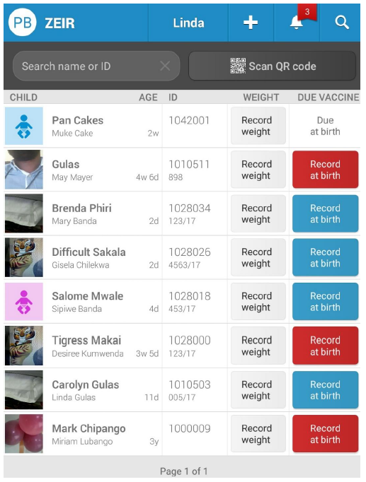
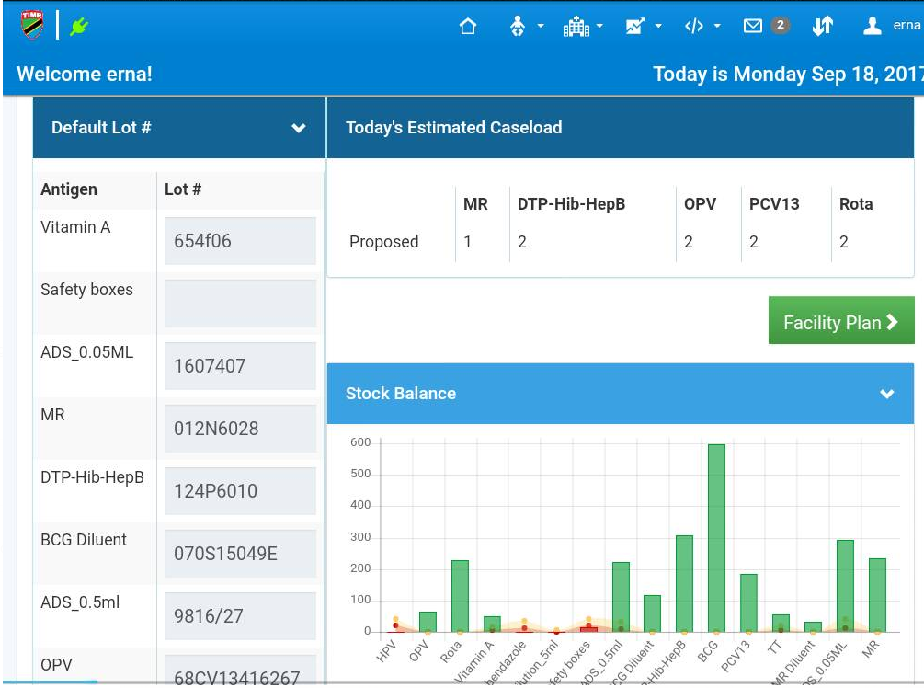
Selecting Solution Technology
DHSI2 – OPEN SRP Platform
Open IZ Platform
Guiding Considerations
  e-Health policy and Strategy requirements
  Existing technology landscape in the country
  Technical skillset and capacity in the country.
  Local ICT infrastructure
  Openness, scalability and re-usability
8
Notes:
Zambia 2014 – 2016
Strengthen HMIS and Smart care
Strengthen harmonization of systems
Governance through SWA and inter-sector collaboration and private sector such as churches health association (CHAZ)
Tanzania 2014 – 2018
Integrate/link related information systems and vertical programs (HIV/TB/malaria/Immunization) HMIS information into DHIS 2.
Establish eHealth standards, rules, and protocols for information exchange (Health facility Registry, Provider, and Client registries
Establish and institutionalize NeHSC & National e-health entity

Slide 9
Challenges to Solution – Immunization service delivery challenges
Lack of reliable, actionable data around immunization particularly defaulters tracking. Lack of quality and accurate data has hindered the ability of health workers and the district health office to track defaulters
Inefficient work processes
Paper-based reporting is tedious and requires cross checking data for accuracy.
Some facilities missing reports due to the lack of available tally sheets and or operational documents
Lack of actionable Vaccine monitoring data
Inefficiency in monitoring vaccine supply chain & wastage at facility level leading to stock outages.
Inaccurate denominator
Inability to trace defaulters
Complexity of data collection tools
Low data use capacity
Lack of visibility of consumption and supplies at facility level

Slide 10
Zambia Electronic Immunization Registry (ZEIR)

Slide 11
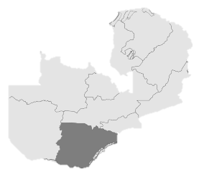
ZEIR Overview and Coverage
The Zambia Electronic Immunization Registry (ZEIR) is a system that has a focus on tracking the healthcare services provided to children under the age of five living in the facility’s catchment areas
ZEIR was built for skilled health workers (Clinical Officers, Nurses, and Environmental Health Technicians and community health workers)
ZEIR was deployed in 2017 after receiving funding from the Bill & Melinda Gates Foundation through the BID (Better Immunization Data) Initiative.
Coverage:
Deployed in all 13 districts in Southern Province with a total population of about 1,806,187.
Currently, deployment covers 300 health facilities
However, this coverage is constantly growing with opening of new health posts.
The Ministry of heath has received funding to expand to another province
Geographic Coverage:
Southern Province, Part of western province
Population:
1,806,187¹
Registration:
+140,000 children are registered
+1,500,000 vaccinations have been administered
+2,000,000 attendance

Slide 12
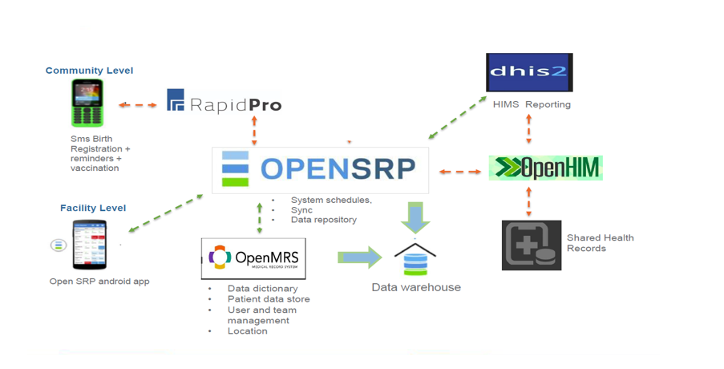
Design: Solution System Architecture
Zeir is powered by OpenSRP and it leverages several other popular open source platforms developed to make it easier to create interactive and intelligent mobile interfaces
Infrastructure considerations
The OpenSRP App is deployed on an Android mobile device running Android .
The OpenSRP server is the system that manages the mobile deployment. synchronizes data across all tablets, tracks changes in forms, provides updates on a regular schedule and integrates with OpenMRS
OpenMRS is the centralized data repository that provides role-based access controls, audits and reporting to other systems
RapidPro which allows syncing of messages to and from your handset
ZEIR is powered by OpenSRP under appache open source license 2.0 http://www.apache.org/licenses/LICENSE-2.0
Notes:
OpenSRP App (Android Mobile Device: The OpenSRP App can be deployed on an Android mobile device running Android Marshmallow (5.0) or greater. The OpenSRP app functions offline and synchronizes data with the centralized server when an internet connection is available.
Key Specifications include:
Running Android 5.0 and above.
Sim or Wi-Fi support
7 inches or above.
Camera: 8MP rear Camera (Essential for QR code Scanning)
OpenSRP Server
The OpenSRP server is the system that manages the mobile deployment. It contains technology that synchronizes data across all tablets, tracks changes in forms, provides updates on a regular schedule and integrates with OpenMRS. Additionally, OpenSRP Server can directly connect with third party systems such as DHIS2, RAPID PRO or Superset
OpenMRS Server
OpenMRS is the centralized data repository that provides role-based access controls, audits and reporting to other systems. It utilizes the transactional data model that has been proven at scale in numerous applications across the globe. This system manages the user access controls in both the centralized server and mobile deployment. It also allows for the separation of data by clinic site and team. The OpenMRS server allows end users to perform patient de-duplication, aggregation and reporting. The OpenMRS server can aggregate data locally and push data to DHIS2 using an Extract Transform Load (ETL) process. placed at each facility captures data entered

Slide 13
Design: Key Skills Set Needs
Skills Set needs
Business analysis skills – Understanding the users business processes
Programming skills:
  Android Mobile app system development
  Java, JavaScript and Python are the key technologies
Data warehousing knowledge
  (ETL Scripting), PostgreSQL.
  Has Superset installed which is used as monitoring tool for visualizations
Database/Server Administration.
  System uses couch db., SQLite database for android.

Slide 14
Functionality: Core Solution components
Although ZEIR is only the vaccination module of OpenSRP, there are 4 different components to the registry that are unique.
STOCK CONTROL
Record all stock activity
Supply forecasting and planning
REPORTING
In-app reporting
Daily tallies for service data
HIA2 reports created
Dropout / coverage
SERVICE
Registration
Unique Identification
QR Code support
Vaccinations
  Vaccine schedule
Growth Monitoring
Weight recording
Growth chart
Z – score calculations

Slide 15
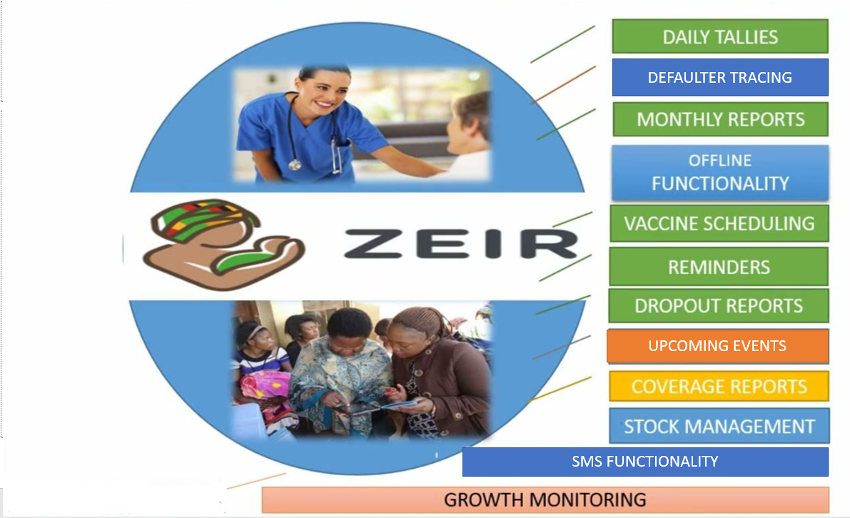
Solutions Capabilities

Slide 16
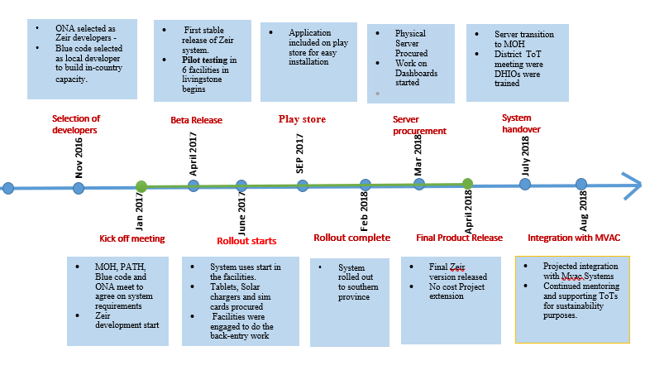
Development: Solutions development timeline
OpenSRP was adapted using the Agile systems development method, which involves a rapid and continuous work cycle utilizing consistent stakeholder feedback and a disciplined prioritization process
LESSONS
Develop with the user in mind – ( user centered design)
Involve all stakeholders at different levels when getting feedback to avoid back and forth.
Build local capacity from onset, ranging from, development/ administration and maintenance
Fail fast – if its not meeting the requirement, look for alternatives

Slide 17
Deployment: approaches, experience & timeframe
OpenSRP was adopted and deployed in southern and part of western province. Deployment to the facilities involved an onsite training approach which included 4 touches (visits)
Touch 1: Introduction, change management on data use.
Touch 2: System training and equipment handover (Users left in training environment)
Touch 3: Facility goes live, observation& monitoring
Touch 4: Subsequent follow-up and troubleshooting and feedback
Average of 20 touches per week
January 2017
March 2017
April
2017
May
2017
August
2017
February
2018
1st release
1st touch*
2nd release
3rd release
DESIGN
(2 weeks)
Work to translate prioritized requirements (gathered before project inception) into visual designs and workflows by meeting with end users, mapping data components, immunization schedules, and reporting requirements.
ADAPT & PILOT
(10 weeks)
Building phase of the project with initial release to gain feedback from end users. This phase is when end users begin to use the system fully in a piloted setting.
UPDATED RELEASE
(8 weeks)
2ND UPDATED RELEASE
(12 weeks)
EXTENDED RELEASE
(4 months)
Feedback was acquired, and the application was updated with new and improved features.
Rolled out to more health facilities and health workers.
More health workers are trained weekly to use the application.

Slide 18
Deployment: Challenges limitations and lessons learnt
Operational
Sync challenges from remote areas. Users have to be encouraged to sync at least once in a month. Otherwise District may not see the numbers.
Abuse of bundles, personalisation of tablets, damaging tablets
Staff retraining due to movements.
Resistance to change
Non use of the system due to low or lack of motivation
Parallel systems running (overloading user)
System Limitations
First time login requires internet connection and system will need to sync once in while with the server for id replenishment.
Does not support Ordering the vaccines from the District.
The stock module Does not track batch/lot numbers of vaccines
The nutritional module does not have Height over weight tracking
Note the specifications of the tablet before installation otherwise you might experience performance /display issues
Lessons Learnt
Have a sustainability plan in place from onset
During deployment, do not treat it as pilot or project, instill ownership from onset.
Have a change management plan in place as resistance will always be there
Customize the system to suit the needs of the users and to be as close to their operations as possible.
Have transitioning plan in place to avoid running parallel systems for a very long time.
Back entry can be a tedious process for the users; unless you have adequate staff Start with a particular cohort and move on gradually.
A solid support structure is important.

Slide 19
Tanzania Electronic Immunization Registry (TIMR)

Slide 20






Overview of TIMR and Coverage
1,321,974 children are registered in Tanzania immunization Registry.
4,360,923 vaccination events recorded in the system
The Tanzania Immunization Registry (TImR) mobile application enables front-line healthcare workers to register, store, and track child immunization information such as what immunizations a child has received and when a child is due for upcoming immunizations.
2,685health facilities in 10 regions in Tanzania
Notes:
It also tracks other key data such as child weight, allergic reactions, and antigen stock levels at a facility. Data entered the TImR app is synchronized wirelessly to a central database
The TImR mobile app functions online with a Wi-Fi connection, but also works offline in cases where no Wi-Fi is available. TImR supports the English and Swahili languages.

Slide 21
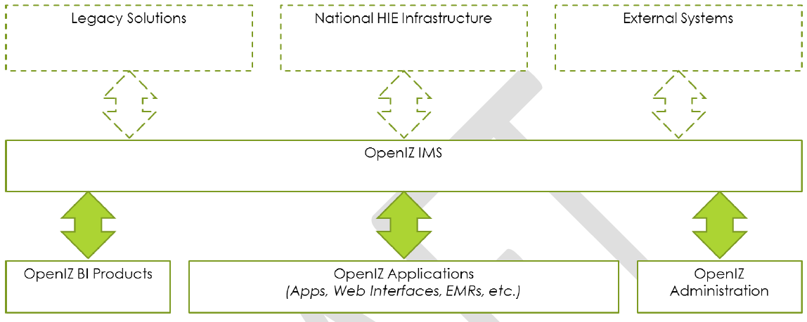
Platform Used to Develop TImR
TImR Solution was build on OpenIz Platform.
Open Immunize is a community software project intended to provide a generic platform upon which jurisdictions can build immunization information systems.
It provides an open source, customizable, enterprise scale jurisdictional IMS solution founded on the tenants of Open Architecture, Interoperability, Security & Privacy and Extensibility.
Notes:
The major architectural components of the OpenIZ solution are:
- The OpenIZ Immunization Management System (IMS) – A specialized expert system which is responsible for forecasting, scheduling, localized reporting, interoperability, contra-indication checking, etc. The IMS represents the core of the OpenIZ solution.
- The OpenIZ Applications – A term used to describe a series of “apps” which are used by end users to operate the IMS solution. OpenIZ applications include (but are not limited to) mobile applications, web interfaces and portals, EMRs (like OpenMRS), and other future client technologies.
- OpenIZ Administrative Portals – A term used to describe tools used by administrators to perform data administration tasks such as concept dictionary maintenance, user administration, etc.
- OpenIZ Business Intelligence Products – A term used to describe tools which can perform business intelligence functions using data in the OpenIZ IMS such as reporting software, big data mining and warehousing, etc.
- Legacy Solutions –The OpenIZ IMS is designed to be capable of interoperating with legacy systems using a variety of standards.
- National HIE Infrastructure – A term used to describe national health information exchange infrastructure to which OpenIZ is not only a publisher of data, but a consumer. Unlike a synchronization solution, OpenIZ is designed to provide on-demand publication and consumption of data contained on the national infrastructure to supplement its data store.
- External Systems – we mean any non-clinical systems with which OpenIZ must interoperate. This includes Logistics Information Management Systems (LIMS) for stock management and other services in country.

Slide 22
Solution Architecture
The Tanzania Immunization Registry (TImR) is a multi-application, scalable immunization registry platform.
TImR consists of many components:
OpenHIE
AdminUI
Mobile UI
Mini IMS
TImR
Jasper ETL
Web UI
Jasper Reports
Notes:
OpenIZ IMS: An open source immunization management system (IMS) which is responsible for forecasting, scheduling and executing business rules, etc. The IMS is also the gateway for collecting immunization summaries about patients and submitting them to the HIE infrastructure.
- Data Marts: A data warehouse of aggregate report data which can be used to easily run reports from OpenIZ based data without introducing load on the transactional system. The data marts are constructed nightly using ETL processing and de-normalize data.
- TImR Web: A customization of the OpenIZ web client. This client is responsible for consuming data from the OpenIZ IMS and rendering a user interface. The TImR web application will primarily be used by district and regional level officers, however because of the nature of the solution, can share code which may be of use to immunizers.
- TImR DC: A disconnected client which operates on Android operating systems. The TImR DC is a customization of the OpenIZ disconnected client and operates a series of HTML5 applets in offline or online mode (depending on internet connectivity). The TImR DC can share applets directly with the web client.
- AVIC: Represents the security console. The AVIC is an open source component which MEDIC has previously developed and will be deployed to work with the TImR services. No development to the AVIC will be undertaken.

Slide 23
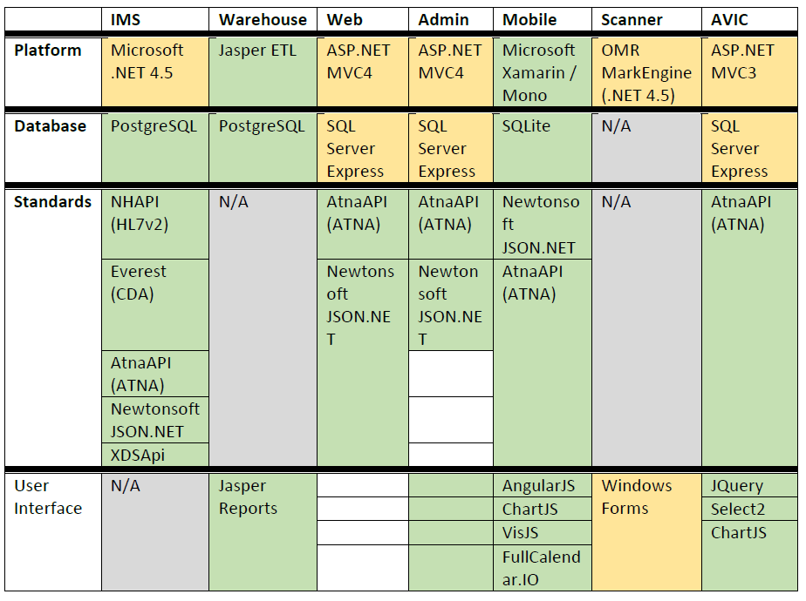
Technologies Used.
Skill set needed
Developer.
Moderate Javascript / HTML5 using AngularJS.
Moderate PostgreSQL skills (for reporting)
Experience with REST APIs (XML).
System Administrator
High technical skill, expertise in systems management., log monitoring, installations.
windows and linux administration skills (creating tasks, backups, etc.)
Notes:
Mobile App interface was developed using Javascript and HTML5
Where Web and Admin Portal was developed using ASP.Net
Object Relational database- Postgres where mobile app store app in local sqlite.

Slide 24
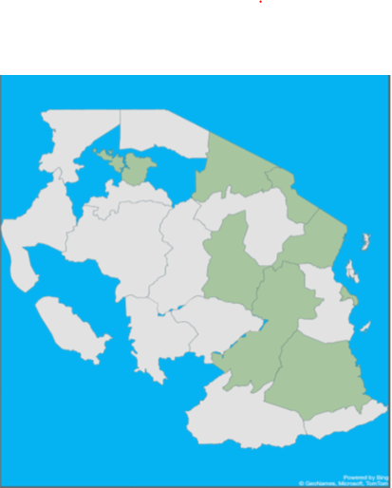

Solution functionalities
TIMR
SMS Reminder
Stock Management
Performance Measurement (Reports)
Client Management
Immunization Management
Growth Monitoring
Notes:
Client management i.e child or mother registration as children are brought to the facility, searching and updating records.
Immunization management i.e administering vaccines, Child schedule management and facility plan.
Facility stock management: Record stock level within the application, adjustment & lot # management & decision supports.
Automated SMS Reminders : sends an SMS to mothers to remind them of missing visits.
Cold Chain Data management : Record fridge temperature, status and alarm episode in the application.
Facility Performance measurement : TIMR auto generates different reports such as coverage, defaulters and dropout with in built decision support such as color codes.
Coverage report (scheduled & target population
Stock balance
Daily traffic management
Defaulter & dropout report

Slide 25
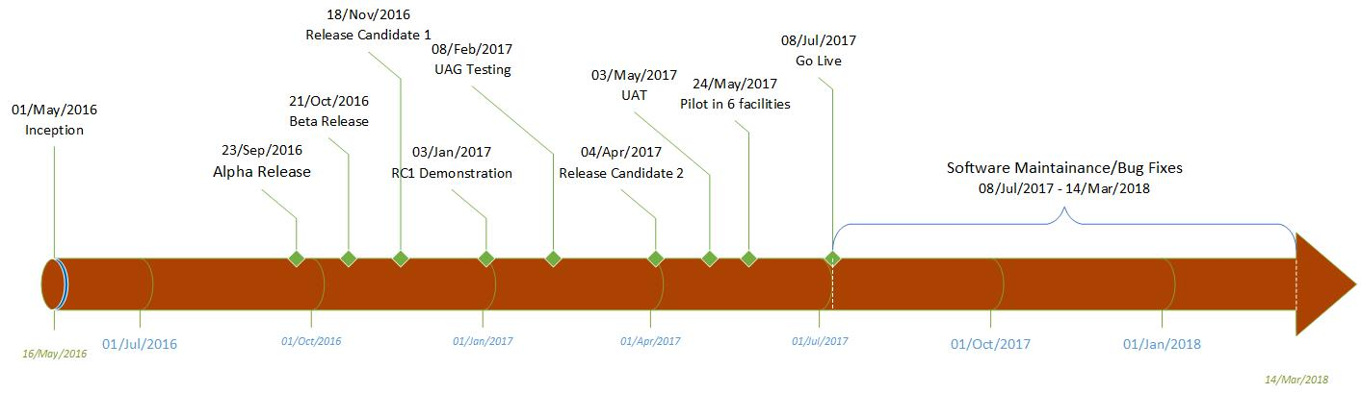
TIMR Development & Deployment
Today
Pilot.
System piloted in 6 facilities in Arusha.
Facilities with different setups i.e best internet connections, moderate internet connections and limited/poor internet connections.
Rollout Approach
1 week TOT training.
At least 5 TOTs from each Districts.
TOTs provides onsite trainings
(1st Visit – Orientation, 2nd Visit : Go live
3rd visit support identified gaps)
Approach was revised to classroom based training.
Notes:
Requirement gathering : The whole process is user centered , requirements were gathered through UAG, user advisory group created to brainstorm and discuss on the requirements and create their expectations because they are targeted users they know what challenges they are facing.
Inception : kickoff meeting was conducted to bring team into perspective, know each team involving in the project, set clear roles and responsibilities for entire team, define communication channels and expectations between developers and project managers.
Design : creates business models and functioning screens that allow you to envision how the software will look and work.
Development : The TImR project was delivered using Agile SCRUM, as such rather than traditional project plans, TImR development is planned as a series of milestone releases with roadmap functionality.
Development was divided in 2 weeks iterations called “sprints”.
Testing : After each milestone release, testing was done using internal team members and UAG (Sharing existing information and knowledge to help with the design of different interventions to address immunization data quality and use in the Arusha region) ,(Providing expertise and strategic advice to the BID Initiative team.
· Meeting regularly to learn of the testing and implementation process and provide feedback on the learnings documented to help with further iterations on the intervention
) , feedback after testing was collected and shared with Developers for fixing.
After RC1 (release candidate 1) system was piloted in 6 facilities for 8 weeks, findings after testing in these facilities were collected and shared with developers.
Insure no bug and all workflows are performing as per design Before we go to roll out.
The system development process reveal that it is critical to test the software as the development is done. You should not wait until everything is finished for you to start testing the system as it will take time to fix the errors, you will be in a hurry and you might not test all aspects of the system and if things doesnt work, you are in danger of ecountering 'system creep'.
Deployment : After fixing all issues found during the pilot testing in 6 facilities , system was rolled out in one region.
Maintenance: After development developers provided (Software maintenance) technical support of 6 months to correct faults and errors in software.

Slide 26
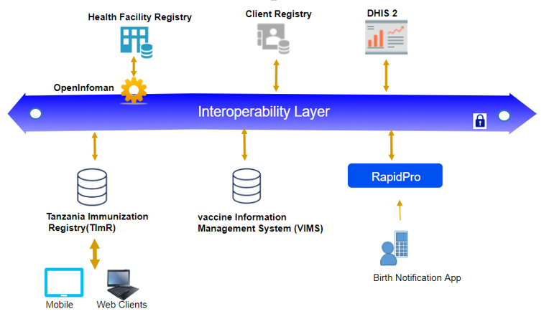
TImR Capabilities
System needs less internet bundle; data is compressed during synchronization.
On device and server back up of data incase system crashes or device stolen; data can still be retrieved.
Ability to work offline for weeks at a time and synchronize data when internet connectivity is available.
Secured and encrypted local storage so data is safe offline.
Interoperable with other systems.
Simplified and automated system upgrades is simple and is done centrally to avoid the need of requiring physical access.
Built in bug & issues reporting

Slide 27
Limitations/Technical challenges.
First login requires internet connections for app to sync with server.
Users are not notified when stock is sent from District level, sometimes they forget to acknowledge stock receipt.
System works offline but for facilities with no connection at all need to find a place to sync data to server.
Staff retraining due to movements. Mentors must be on top of things in retraining if need arises.
Some of the facilities are relying on a specific health care worker when it comes to system use which becomes a problem when that particular person is not around.

Slide 28

Thank you!

Slide 29
Questions?
29

Slide 30

Thank you for connecting with us!

