Slide 1
BLN Webinar on “Piloting the E-Tracker App in DHIS2 in The Gambia”
Speaker: Mr. Mbye Njie, EPI, Ministry of Health and Social Welfare, The Gambia
Host: Catherine Muyawala, Community Coordinator, BLN

Slide 2
Background on the bid REGIONAL MENTORS

Slide 3
BID Regional Mentors
The BID Initiative has transitioned to BID Regional;
To provide targeted technical support African countries investing or interested in data quality and use interventions for improved coverage of immunization;
BID Regional will pair countries with technical advisors experienced in:
Electronic Immunization Registries (EIRs);
Change Management strategies; and
Data-use culture building tools.

Slide 4
The bid learning network

Slide 5
The BID Learning Network
BLN will remain a:
Conduit of learning and sharing of experiences for peers, partners, donors and technical experts;
Platform for information exchange & technical resource sharing, peer-to-peer interaction and exchange of promising practices;
Platform that connects innovations coming out of implementation activities to country managers and professionals that need to be aware of these advancements for improved health program outputs; and
Platform that brings like minds together to brainstorm matters of mutual interest that contribute to better health outcomes

Slide 6
“Piloting the e-tracker APP in DHIS in The gambia”

Slide 7
Introducing our Speaker: Mbye Njie
Public Health Specialist with 18 years experience;
Focus on immunization, disease surveillance and other public health-related activities;
Divisional Vector Control Officer (2006);
Senior Malaria Control Officer (2011 – 2012);
STOP Program Consultant in Nigeria (2013 to 2014);

Slide 8
Introducing the Speaker (cont’d)
Capacity Building Manager under the Expanded Program on Immunization in The Gambia - responsible for strengthening the program and coordinating training activities.
Currently the Senior VPD Surveillance Officer, Gambia EPI.
Holds a HND in Public Health, MSc in Public Health Entomology, and certificates in Management Skills for Supervisors and Field Epidemiology

Slide 9
introducing the topic: what you will learn

Slide 10
Introducing the Topic: What you will learn
In this webinar, the speaker will share:
Gambia’s experience with piloting the e-Tracker App in the
DHIS2
Highlights of the process, software applications,
accomplishments, challenges and lessons learned
Findings and recommendations from the final evaluation
This webinar will be of interest to Data Management Specialists, EPI Managers, Health Management Information System (HMIS) Specialists and other health care specialists committed to improving data collection, quality and use across the health system.

Slide 11
Thank you & connect with us!

Slide 12
Thank you

Slide 13
Piloting the E-Tracker App in DHIS2 in The Gambia
Mbye Njie
Senior Surveillance Officer
Expanded Program on Immunization

Slide 14
Outline
Objectives
Background information of The Gambia
The process of the Pilot
The Application
Accomplishments
Challenges
Lessons Learnt
Evaluation findings

Slide 15
Objectives
Understand the process Gambia took in piloting E-Tracker
Have an insight of the application /software the Gambia is using
Understand the lessons learnt, challenges and recommendation of the E-Tracker Pilot
Share the findings of the final evaluation

Slide 16
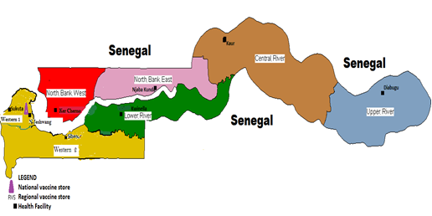
Map of The Gambia Showing Health Regions

Slide 17
Demographic Information
Regions | Total Population | LiveBirths | Surviving Infants | Under 15 Pop | Under 5 Pop | Pregnant Women | CBA Women
Western Health Region 1 | 812395 | 32479 | 30179 | 365578 | 194975 | 32479 | 178,727
Western Health Region 2 | 345506 | 14256 | 13392 | 155478 | 82921 | 14256 | 76,011
North Bank West | 112111 | 5669 | 4712 | 50450 | 26907 | 5669 | 24,664
North Bank East | 121369 | 5635 | 4734 | 54616 | 29129 | 5635 | 26,701
Lower River Region | 82526 | 4411 | 4086 | 37137 | 19806 | 4411 | 18,156
Central River Region | 224361 | 12996 | 12396 | 100962 | 53847 | 12996 | 49,359
Upper River Region | 233883 | 13522 | 12628 | 105247 | 56132 | 13522 | 51,454
National | 1932151 | 88968 | 82127 | 869468 | 463716 | 88968 | 425073

Slide 18
Notes:
Source: JRF Reports

Slide 20
Process
The Gambia has been using the District Health Information System (DHIS2) since 2009
Immunization records are recorded manually at service delivery points
Monthly returns sent manually/electronically
Started thinking of better solutions

Slide 21
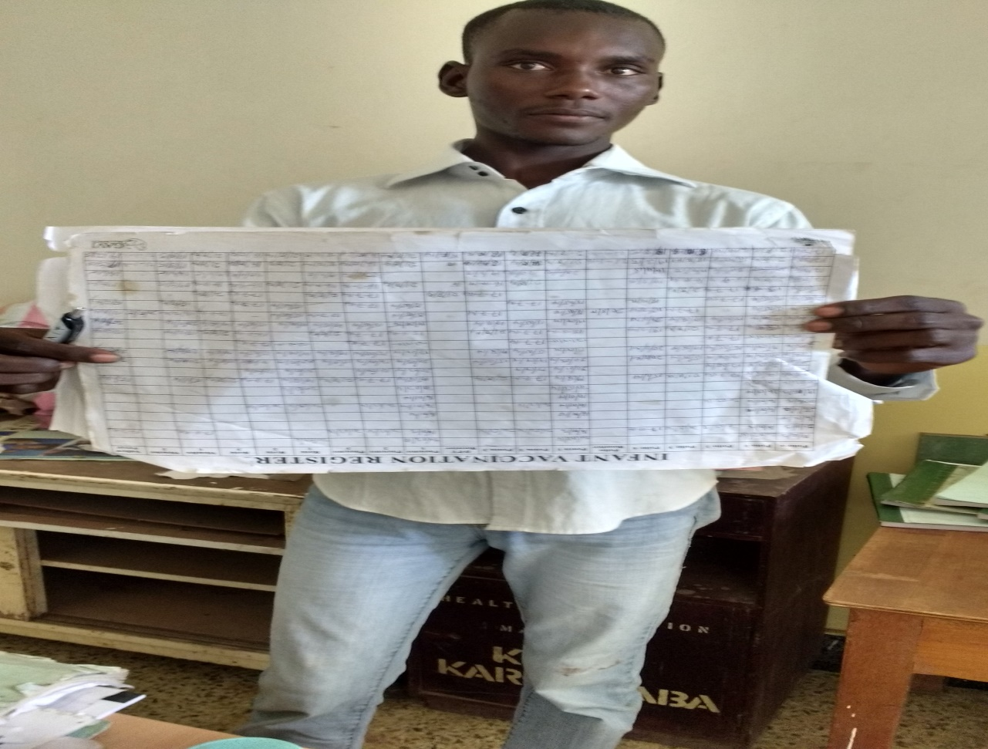
Paper-based system

Slide 22
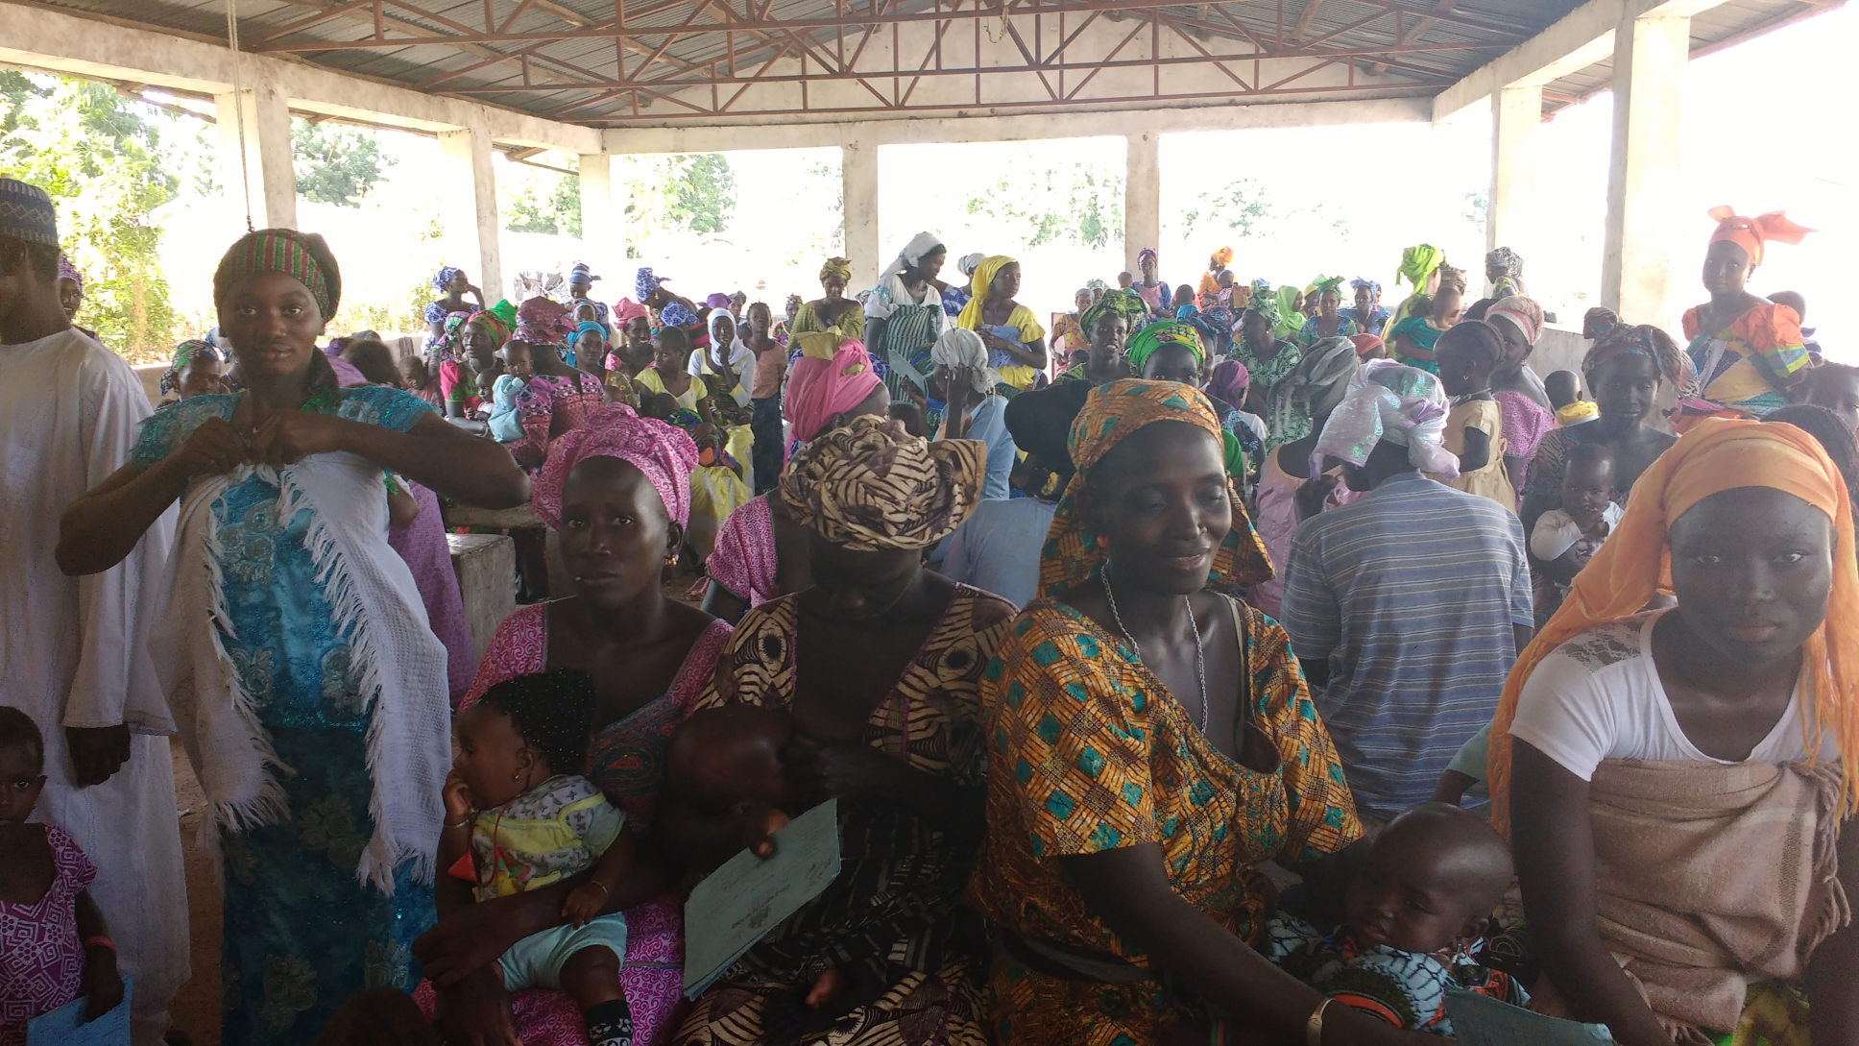
Busy RCH sites

Slide 23
The Breakthrough
Dakar Meeting in May 2015
Tanzania December 2015
Costa Rica/PAHO EIR meeting
Ghana meeting
Study visit to VaxTrac Benin
Uganda CM meeting
Small Grant Award
Notes:
Dakar Meeting in May 2015 and Tanzania December 2015
Costa Rica/PAHO EIR meeting
Ghana meeting
Study visit to VaxTrac Benin
Uganda CM meeting

Slide 24
Decision Making
National meeting held where HMIS department presented on the Tracker Capture of the DHIS2
Decision was made to pilot in Western Region 1 where some facilities have internet and DHIS2

Slide 25
Description
A component of the DHIS2
Being piloted in 2 health facilities
Each immunisation officer has a username
National and Regional supervisors usernames

Slide 26
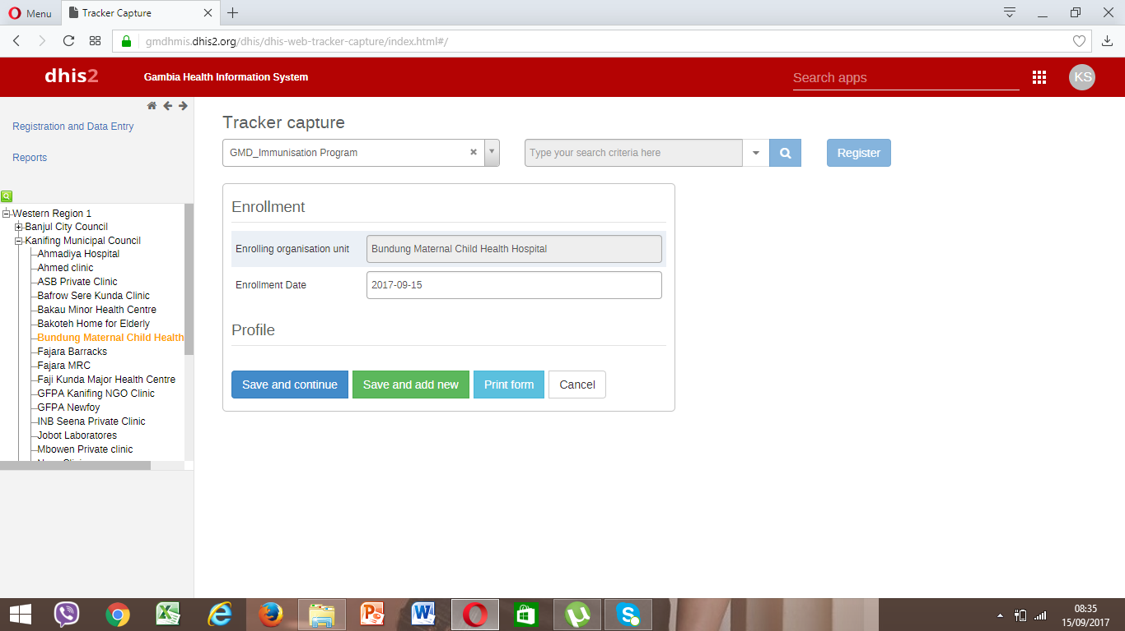
The E-Tracker
The Tracker is an extension of the DHIS 2 platform
DHIS2 is an open source software

Slide 29
Accomplishments
Adaptation and Customization
Procurement of 11 laptops with antivirus and 4 data cards
Training of health workers and their supervisors
Orientation of stakeholders
Successful implementation
Final Evaluation

Slide 30
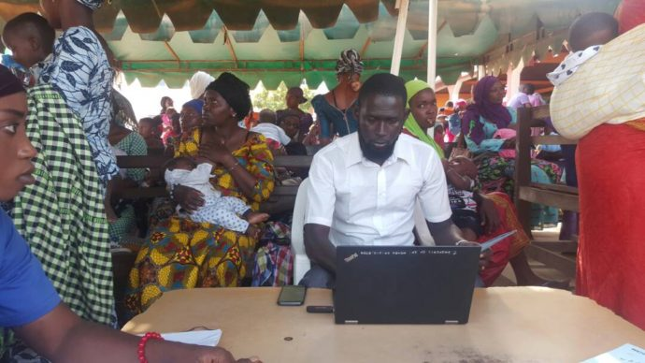
Kemo Sonko at Bundung Maternal and Child Health hospital had this to say…
“Definitely the E-Tracker has added value to the work and has eased the service for us. As of last week, two women came, they lost their cards, what I told them was can I have their children’s names and I just punched the names in the system and everything became plain and I have to extract their information from the E-Tracker system to their IWC cards. It was just a click of a button every information was produced. They were amazed and were encouraging others to have patience to get their children registered”

Slide 31
Challenges
The use of both manual and the electronic systems in the pilot health facilities
The issue of internet connection
Improper handling of devices and low ICT skills
Frequent staff turnover
Infrequent supportive supervision

Slide 32
Lessons Learnt -1
Highly trained human resource is very vital in implementing any intervention.
There is the need to assess the human resource availability and training requirements before implementing such projects.
Staff rotation should be minimized where possible
regularly train health workers on the DHIS2 and its related applications to build their confidence
High level stakeholder involvement is very crucial. The orientation of decision makers on the E-Tracker got a positive response from the immunisation decision making body.

Slide 33
Lessons Learnt -2
It is important to create a sense of ownership among service providers
The system should reduce workload for health workers and waiting times for clients
The use of two systems in a pilot area should be discouraged.
The two systems may create undue resistance by health workers as it will not show the efficiency of the new system being promoted. It will rather increase their workload and discourage them in using the new system.

Slide 34
Lessons Learnt -3
The platform (Software or application being used for electronic immunisation registry) need to support both online and offline modes
Prompt reactions to technical issues is required to make the change stick
Supportive supervision, monitoring and evaluations activities should be incorporated into the budgeting

Slide 35
FINAL EVALUATION
Assess user knowledge, attitudes and practices with regard to E-Tracker in the DHIS2 software as well as determine the extent of implementation of E-tracker guidelines.
Understand best practices and challenges to achieving high and timely immunization coverage reports.
Assess frequency, timeliness and quality of supervision of Central and regional levels of the participating health facilities on the E-tracker in the DHIS2 pilot.
Assess country readiness for national rollout and provide an estimated cost.

Slide 36
Findings 1
Coverage data captured in the E-Tracker from January 2017 to December 2017 show that both facilities have performed well at 76% for FajiKunda and 62.3% for JFPH
Health workers demonstrated a good knowledge and skills on the use of the software

Slide 37
Findings 2
The lack of reliable internet services have been largely blamed for the underperformance
Supervision from all levels of the health system has not been as regular and consistent as required

Slide 38
Findings 3
The evaluation has conclusively shown that it is possible to undertake a phased out national rollout provided the required resources are made available.
It is estimated that approximately $225,000 would be required for the rollout reaching all health facilities in the country.

Slide 39
Bottlenecks
System functionality dependant on availability of electricity and internet services,
Limited bandwidth preventing continuous internet access,
Limited laptops especially in facilities with large monthly targets for immunisation,
Data bundles allocated to the two health facilities are not sufficient to last a whole month.

Slide 40
Short Term Recommendations from the Evaluator
Treat as urgent shifting from laptops to Tablets and also shift from the online version of the E-Tracker to the offline mode to avoid frequent interruption as revealed during the evaluation.
Consider formulating a policy that allows the constitution of a taskforce and institutionalized quarterly joint review of data.
ICT to retrain and equip staff with all the required skills to realize the best out of what the E-Tracker can offer, including the analysis and interpretation of multiple data variables.
ICT and EPI working together, should undertake problem solving “hands-on” training supervision in the two pilot sites at least once weekly during the first three months after installation and training on the offline version of the E-Tracker.
RHDs as frontline supervisors should participate in all E-Tracker related skills training and to revise their supervision checklist to include issues around the digital immunization register

Slide 41
Long Term Recommendations from the Evaluator
EPI to consider a phased expansion strategy, gradually moving from one region to another at an interval of two years to allow for consolidation of gains in new expansion regions.
Undertake fundraising activities such as the preparation of high quality funding proposals and share with potential donors including PATH, Gavi, UNICEF and WHO.
Use higher level authority such as the Permanent Secretary and the Minister of Health and Social Welfare to explore possibility of private sector participation and financing of equipment and internet connectivity costs.
The EPI Management and especially the RHDs must endeavour to undertake regular supervision to support implementation and post implementation regions.

Slide 42
Thank You

