Slide 1
JLN Information Technology Track:
Collaborating Across Countries for Health Insurance Information Systems
An example of using a network and common tools
Kate Wilson, PATH
October 11, 2012

Slide 2
The JLN is growing in membership and drawing on an increasing number of resource countries
Current JLN Countries
Ghana
India
Indonesia
The Philippines
Thailand
Vietnam
New JLN Countries
Kenya
Nigeria
Mali
Malaysia
Prospective JLN countries
South Africa
Rwanda
JLN Resource Countries
Colombia
Chile
Brazil
Mexico
Taiwan
South Korea
Estonia
Kyrgyzstan
Hungary

Slide 3
What are the JLN’s goals?
Translating ideas into action
Enabling
Country
Progress
Translating evidence into actionable reforms at the policy and operational level.
Changing behavior through knowledge acquisition
Increasing Knowledge
Increasing the understanding of policies and
operational techniques that work best for reaching
universal health coverage.
Creating an atmosphere for shared learning
Improving Implementation
Testing innovative methods for improving the implementation of UHC within member countries
Creating Community
Fostering community and increasing shared learning among countries pursuing universal health coverage.

Slide 4
Focus of the JLN
Health Data Dictionary
Common E-claims
Standards selection
Provider Management
Shared Common Architecture Requirements Standards Guidelines etc. | Country Specific Architecture Requirements Standards Guidelines etc.
Shared Common Solutions Software Hardware Services etc. | Country Specific Solutions Software Hardware Services etc.
Coordinate with country led planning
Develop Open HDD
Mobile Payments
Adapt COTS or Build FOSS
Support country led deployments with partners like GIZ
Notes:
People often ask our team what are the benefit of these requirements and how do they relate to what we are doing in country…..Our focus is on the common but what does that mean? Essentially, as systems people, we believe that there is some element of work that will be common amongst members. You may all solve how you do enrollment for instance differently but you all need to identify a person and verify that they have coverage. This is an example of a global common requirement. In addition, many countries are struggling with the question on the usage of HL7 or whether or not to develop a standard set of formats. Our job is to help offer some perspectives on this from across the JLN and other countries.
Let me emphasize, our work is not focused on telling any country what to do or not do but rather, help you understand what are some of the issues that then will need to grappled with at the country level.

Slide 5
How does it work in practice
http://player.vimeo.com/video/51764451?badge=0

Slide 6
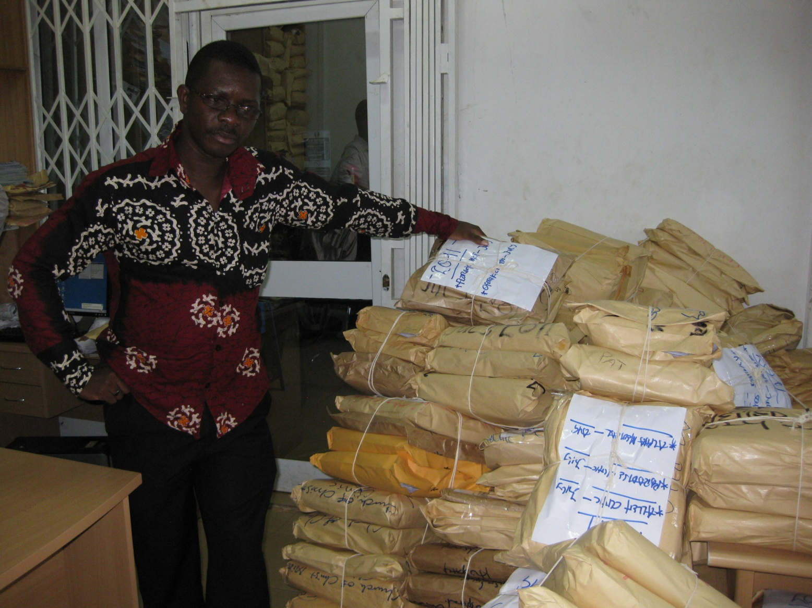
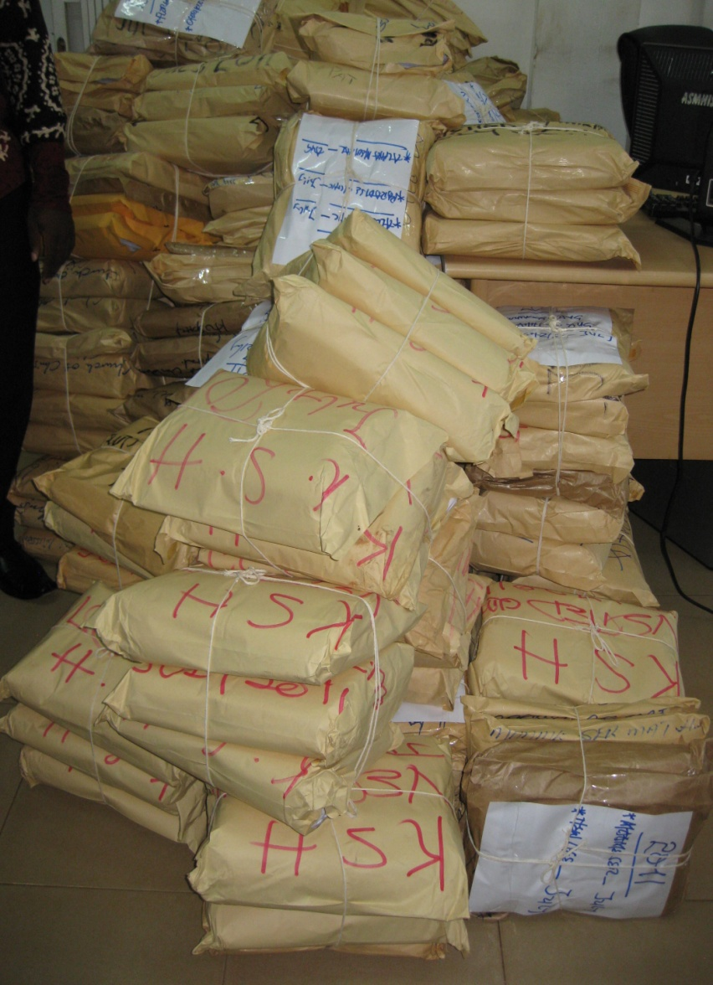
What is an example of the IT problems?
Need a bit more focus here
Most people start here
Claims Backlog in Ghana
1
2
3
4
Design
Develop
Deploy
Analysis
Context
Problems
Users
Processes
Requirements
CFS2*
Specifications
Data Model
User Interface
Device Types
Interfaces
Standards
SDLC*
Dev Tools
Data base
OS*
Network
Road Map
User Training
Migration Plan
Infrastructure
TCO*/Budget
Support Staff
Maintenance
*”CFS2” conditions for sustainability and scalability, “SDLC” software development life cycle, “OS” operating systems, “TCO” total cost of ownership.

Slide 7
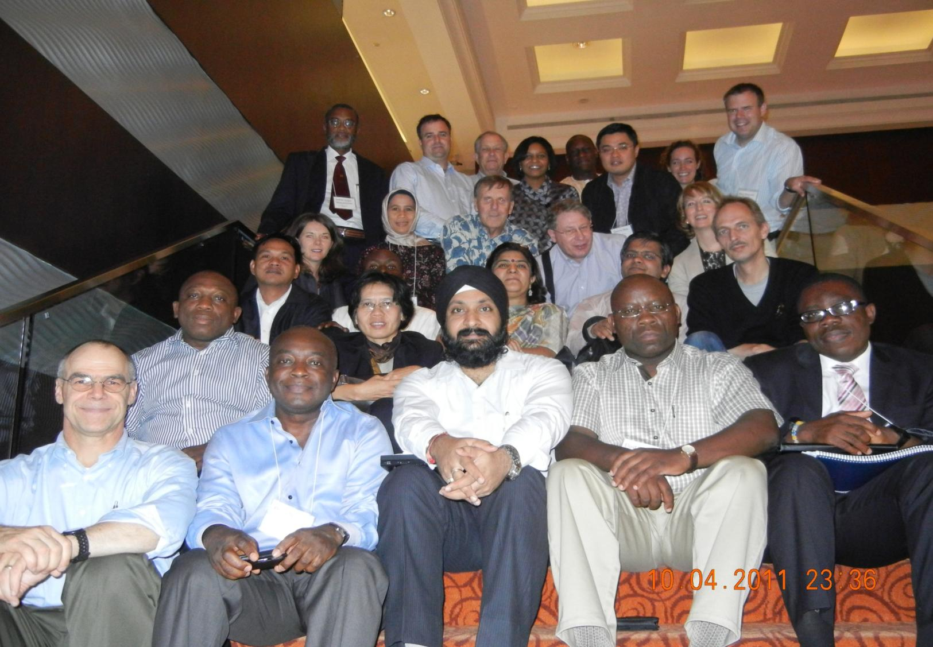
What is our approach?
Shared Common Architecture Requirements Standards Guidelines etc. | Country Specific Architecture Requirements Standards Guidelines etc.
Shared Common Solutions Software Hardware Services etc. | Country Specific Solutions Software Hardware Services etc.
If you want to go fast, go alone.
If you want to go far, go together.
African Proverb
Notes:
People often ask our team what are the benefit of these requirements and how do they relate to what we are doing in country…..Our focus is on the common but what does that mean? Essentially, as systems people, we believe that there is some element of work that will be common amongst members. You may all solve how you do enrollment for instance differently but you all need to identify a person and verify that they have coverage. This is an example of a global common requirement. In addition, many countries are struggling with the question on the usage of HL7 or whether or not to develop a standard set of formats. Our job is to help offer some perspectives on this from across the JLN and other countries.
Let me emphasize, our work is not focused on telling any country what to do or not do but rather, help you understand what are some of the issues that then will need to grappled with at the country level.

Slide 8
How this approach leverages resources?
Multi-Country Requirements & Standards
Collaborative
Multi-Country Solution Collaborative
Cost
1st
Country
1st
Country
2nd
2nd
3
4
5
3
4
5
Time

Slide 9
What are the steps in CRDM?
Domain – set of functions and processes that define the work of a specific area of the larger health system, i.e. health financing
Process Framework – set of processes that define the boundaries of a domain and the relationships between them and other systems and domains.
Business Process – A set of activities and tasks that logically group together to accomplish a goal or produce something of value for the benefit of the organization, stakeholder, or customer
Activity/Task Model – visual representation of a business process in terms of tasks, sets of tasks and decision points in a logical workflow used to enhance communication and collaboration among users, stakeholders, and engineers
Requirement – a statement that describes what an information system must do to support a task, activity or decision. These are non-technology statements that usually begin with “the system must or shall…”

Slide 10
What is the process framework?
National policy regarding target population set by country
Scheme Policy
Benefit Package
Formulary
Provider Rates
Eligibility Requirements
Provider Policy Setting
Premium Setting
Rules
Fundamental System
“Factory”
Beneficiary Management
Provider Management
Premium Collection
Claims Management
Accounting
Data Provides
Policy Guidance
Analyzing
Performance
Care Management
Utilization Management
Provider Quality Management
Fiduciary Fund Management
Actuarial Management
Medical Loss
Audit/Fraud
Data & Feedback
Change Mgmt
Notes:
Working with global experts, our team developed this overview of the main components of a national health insurance system. The “Factory” and “AP” sections highlight some of the core aspects covered by an information system. Our business process framework developed the key inputs/outputs at a general level of each of these categories and we are working on developing draft requirements which flesh out each of these areas.

Slide 11
What are the steps in CRDM?
Domain – set of functions and processes that define the work of a specific area of the larger health system, i.e. health financing
Process Framework – set of processes that define the boundaries of a domain and the relationships between them and other systems and domains.
Business Process – A set of activities and tasks that logically group together to accomplish a goal or produce something of value for the benefit of the organization, stakeholder, or customer
Activity/Task Model – visual representation of a business process in terms of tasks, sets of tasks and decision points in a logical workflow used to enhance communication and collaboration among users, stakeholders, and engineers
Requirement – a statement that describes what an information system must do to support a task, activity or decision. These are non-technology statements that usually begin with “the system must or shall…”

Slide 12
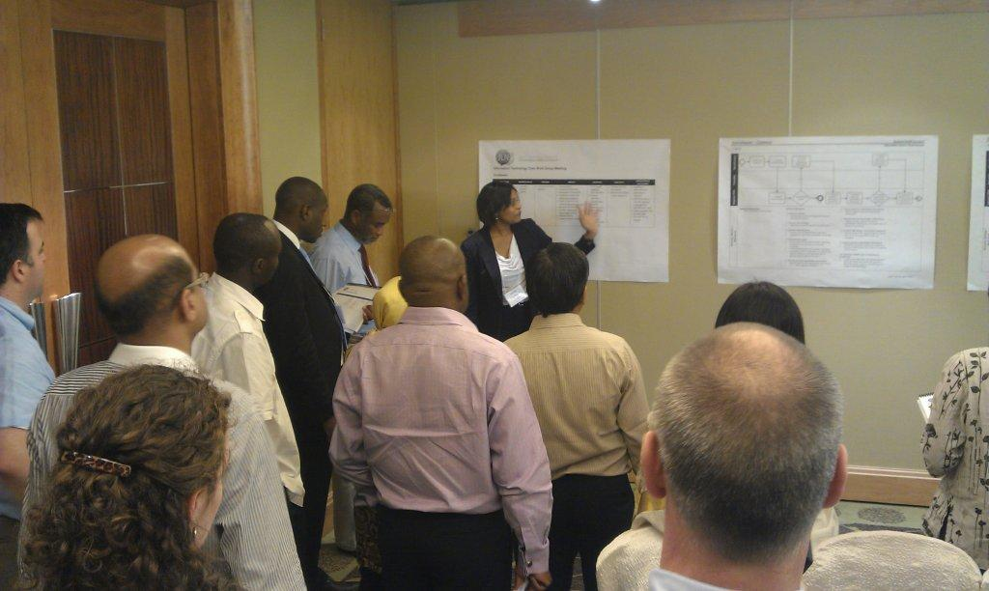

Slide 13
What is the business process matrix?
Illustration of all possible inputs, outputs and tasks a system may need to perform for consideration purposes

Slide 14
What are the steps in CRDM?
Domain – set of functions and processes that define the work of a specific area of the larger health system, i.e. health financing
Process Framework – set of processes that define the boundaries of a domain and the relationships between them and other systems and domains.
Business Process – A set of activities and tasks that logically group together to accomplish a goal or produce something of value for the benefit of the organization, stakeholder, or customer
Activity/Task Model – visual representation of a business process in terms of tasks, sets of tasks and decision points in a logical workflow used to enhance communication and collaboration among users, stakeholders, and engineers
Requirement – a statement that describes what an information system must do to support a task, activity or decision. These are non-technology statements that usually begin with “the system must or shall…”

Slide 15
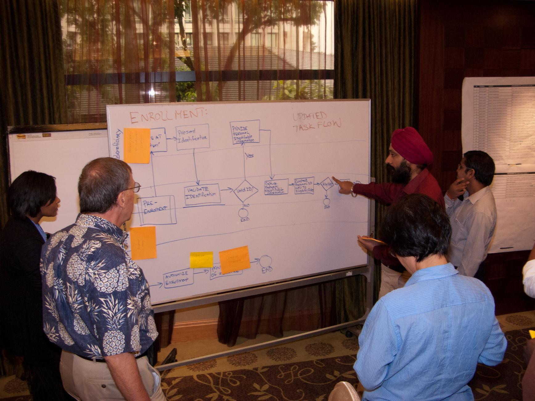

Slide 16
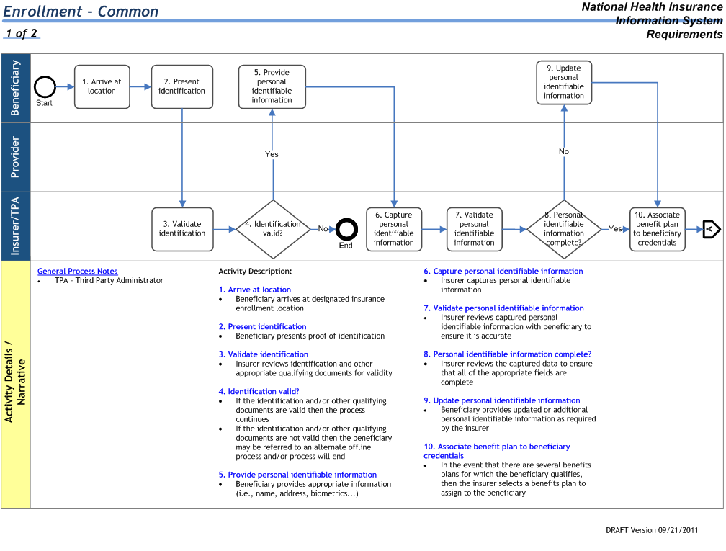
What is common task flow?
Where the work takes place
Person who does the work
Decision point in the work flow
Critical clarification or annotation
Capture rules, comments and feedback
Discrete work activity or task

Slide 17
What are the steps in CRDM?
Domain – set of functions and processes that define the work of a specific area of the larger health system, i.e. health financing
Process Framework – set of processes that define the boundaries of a domain and the relationships between them and other systems and domains.
Business Process – A set of activities and tasks that logically group together to accomplish a goal or produce something of value for the benefit of the organization, stakeholder, or customer
Activity/Task Model – visual representation of a business process in terms of tasks, sets of tasks and decision points in a logical workflow used to enhance communication and collaboration among users, stakeholders, and engineers
Requirement – a statement that describes what an information system must do to support a task, activity or decision. These are non-technology statements that usually begin with “the system must or shall…”

Slide 18
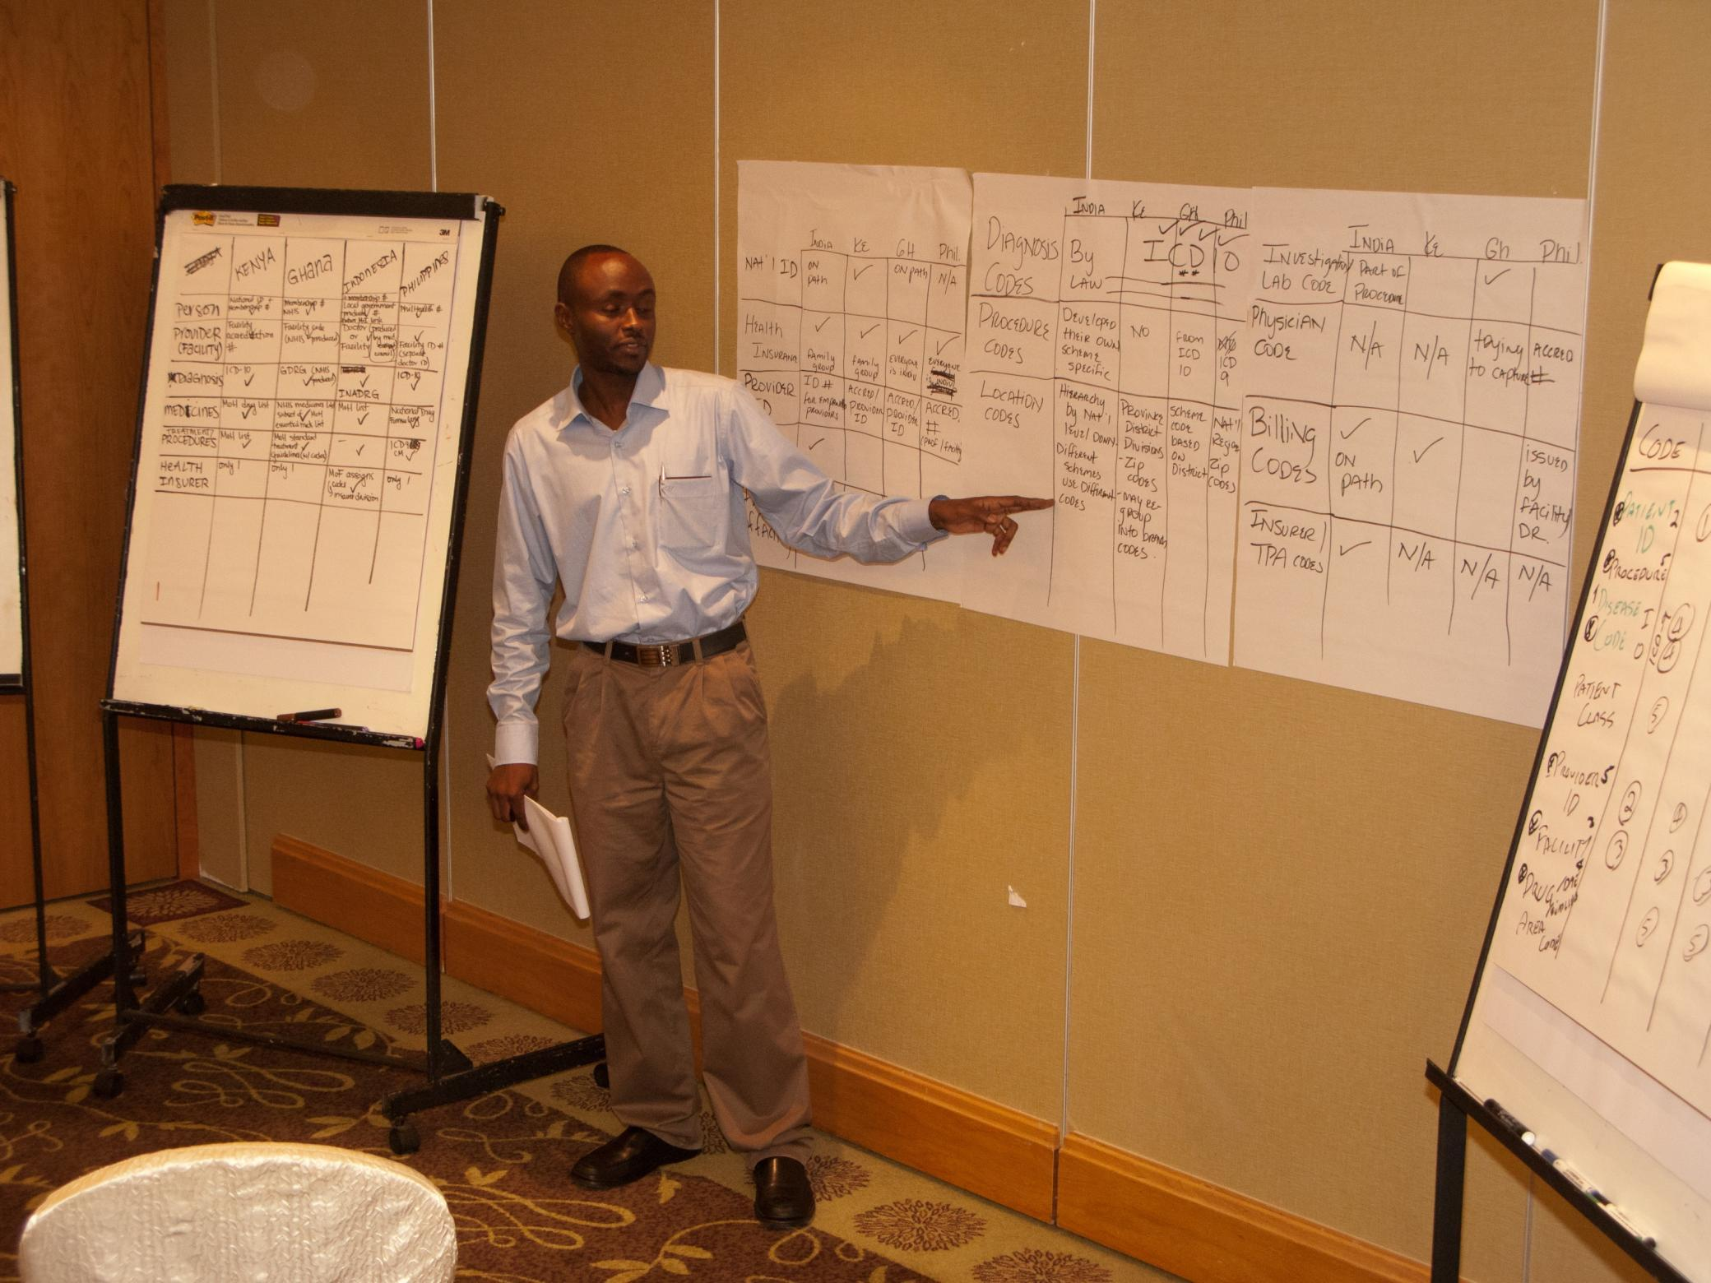

Slide 19
What is a draft requirement catalog?

